Slide 1
Edge Computing
Lecture 07: Hardware and Accelerators

Slide 2
Recap
World of ML
Neural network: terminology
Common building block: layer
Convolution neural network
Pruning
Quantization

Slide 3
Agenda
ML on hardware
CPU
Memory
Cache
RISC vs CISC
Special accelerators
Sensors

Slide 4
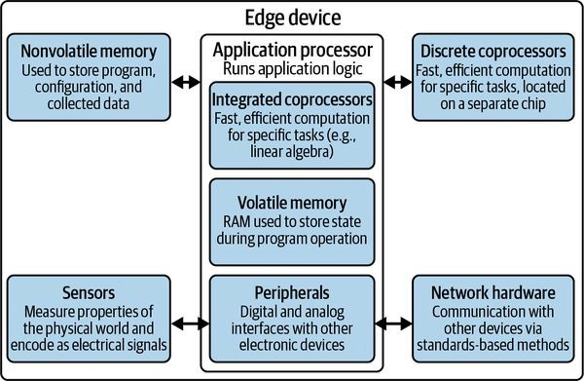
Edge Device Hardware Architecture

Slide 5
Edge Device Hardware Architecture

Slide 6
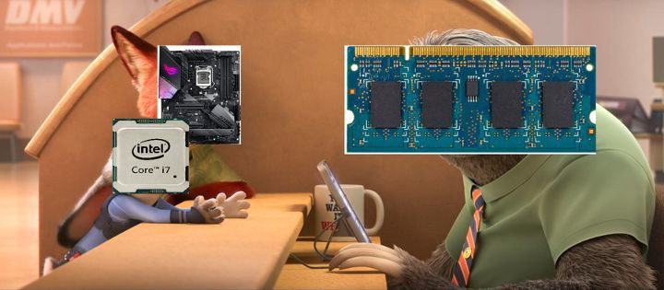
CPUs
Clockspeed
Cores
Threads
Memory speed
Cache size
Example: Intel® Core™ i9 processor 14900K
Movie: Zootopia

Slide 7
Edge Device Hardware Architecture

Slide 8
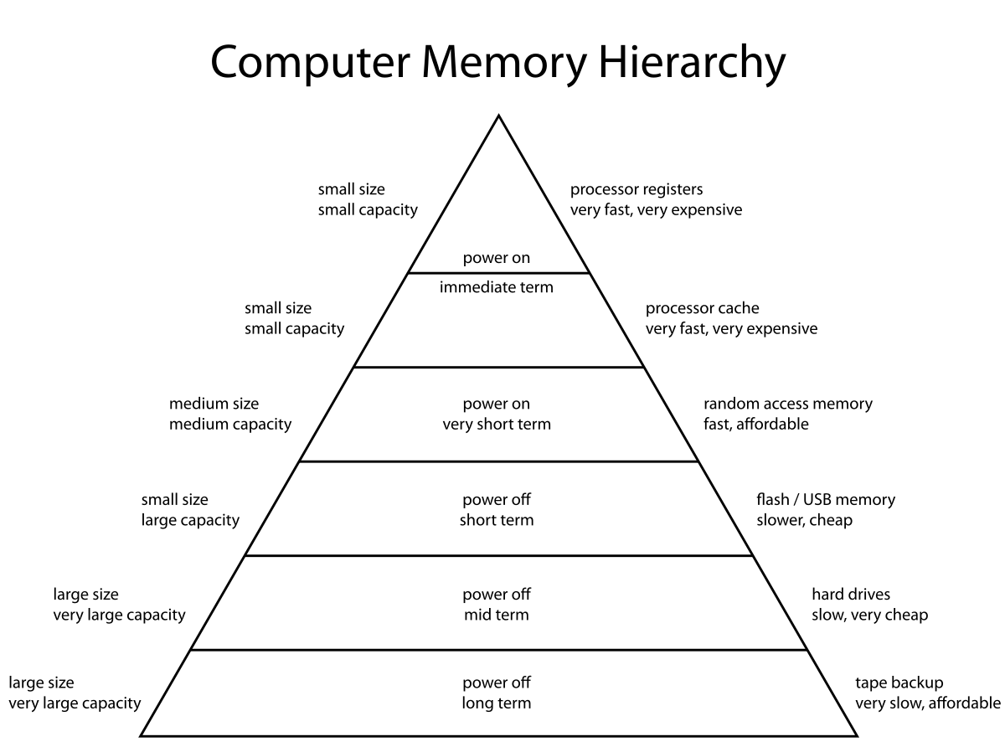
https://en.wikipedia.org/wiki/Memory_hierarchy

Slide 9
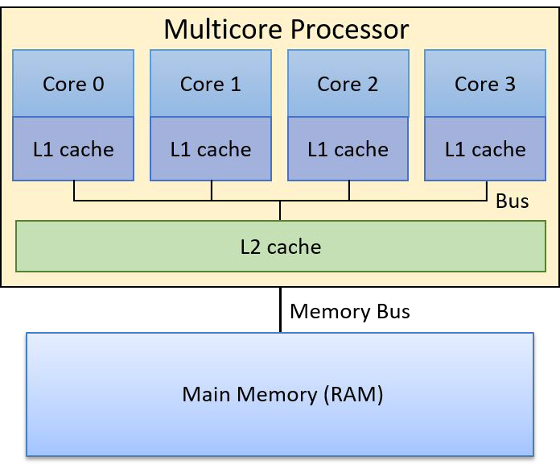
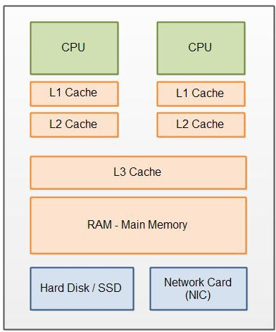
Cache
L1 Cache is the fastest
L1 & L2, bigger impact
Cache level is limited
Cache hit vs miss
https://diveintosystems.org/book/C11-MemHierarchy/coherency.html https://jenkov.com/tutorials/java-performance/modern-hardware.html

Slide 10
Heat
Intel i7:
Operates at 165-195 W
Produces 45 W of heat
ARM
Operates at 4-5 W
Produces 3W of heat

Slide 11
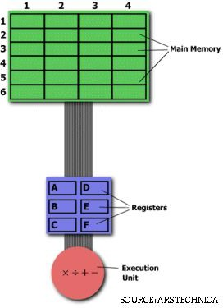
RISC vs CISC: Example
Reduced Instruction Set Computer (RISC)
LOAD A, 2:3
LOAD B, 5:2 PROD A, B STORE 2:3, A
Complex Instruction Set Computer (CISC)
MULT 2:3, 5:2
https://cs.stanford.edu/people/eroberts/courses/soco/projects/risc/risccisc/

Slide 12
RISC vs CISC
Complex Instruction Set Computer (CISC)
Emphasis on hardware
Includes multi-clock complex instructions
Memory-to-memory:
"LOAD" and "STORE"
incorporated in instructions
Small code sizes, high cycles per second
Transistors used for storing complex instructions
Reduced Instruction Set Computer (RISC)
Emphasis on software
Single-clock, reduced instruction only
Register to register:
"LOAD" and "STORE" are independent instructions
Low cycles per second, large code sizes
Spends more transistors on memory registers

Slide 13
Why RISC?
Fixed one-clock-cycle instruction -> structured for pipelining
Less transistors storing only small set of simple instruction
Lazy erasing of instruction from registers

Slide 14
ARM vs Intel
Intel processors are performance oriented. They use dynamic size instructions and are about the state of the art for general purpose computing (along with AMD)
ARM (Advanced RISC machine) are meant to be energy and space efficient.
Intel is CISC (not really but it’s complicated) and ARM is RISC

Slide 15
Edge Device Hardware Architecture

Slide 16
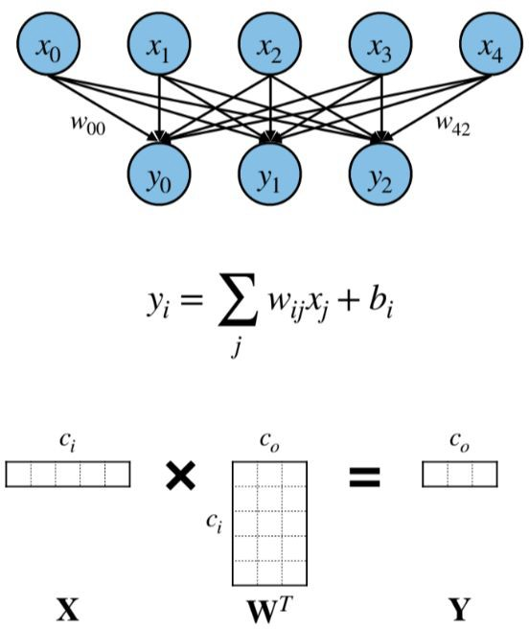
GPU
Graphical processing unit
Designed for display and rendering
Highly parallel computation
suitable for general purpose computation that is parallelizable (GP-GPU)
E.g. matrix multiplication

Slide 17
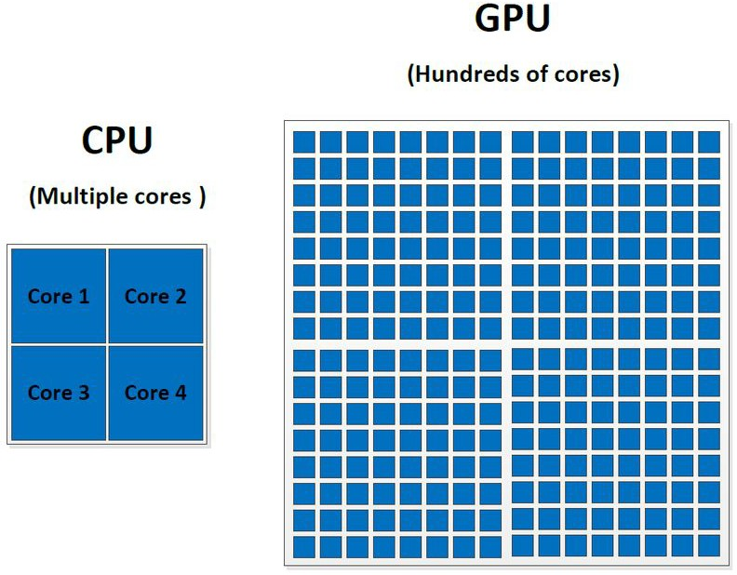
GPU vs CPU
https://www.researchgate.net/figure/CPU-vs-GPU-architecture-each-blue-square-represents-one-core_fig1_323281068

Slide 18
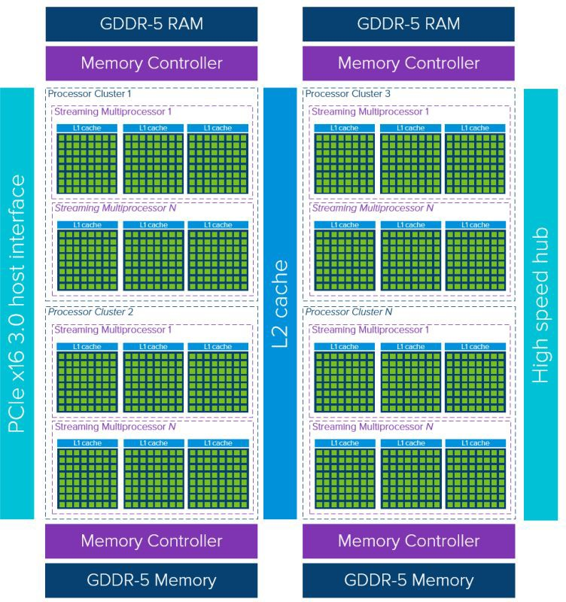
GPU vs CPU: Memory architecture
https://nielshagoort.com/2019/03/12/exploring-the-gpu-architecture/

Slide 19
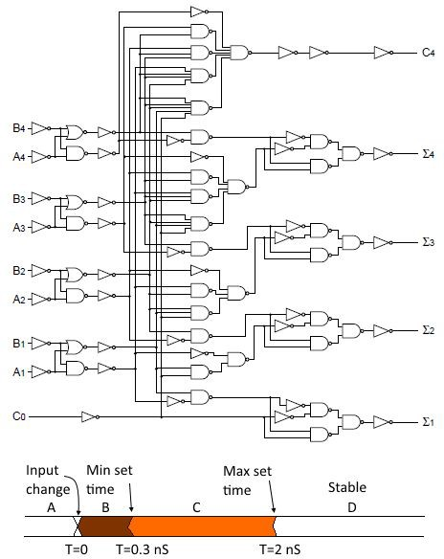
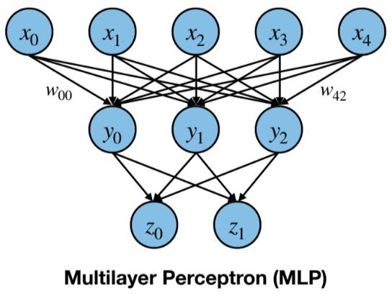
Systolic Array
Static circuit
Bake a DNN into silicon
An in-depth look at Google’s first Tensor Processing Unit (TPU)

Slide 20
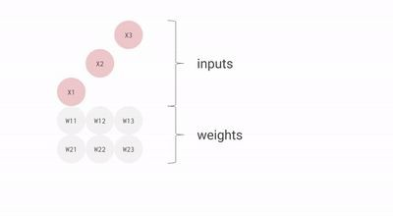
Systolic Array
Data flow in waves (heart pumps blood)
X
=
W
X
Y
An in-depth look at Google’s first Tensor Processing Unit (TPU)

Slide 21
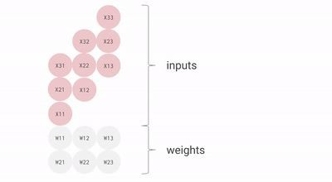
Systolic Array
Data flow in waves (heart pumps blood)
X
=
W
X
Y
An in-depth look at Google’s first Tensor Processing Unit (TPU)

Slide 22
Why Systolic Array?

Slide 23
Why Systolic Array?
Fixed add/mul cells
High throughput
Power efficient

Slide 24
FPGA vs ASIC
Field Programmable Gate Arrays (FPGAs)
Programmable hardware fabric
Flexible for different functions
Application-specific integrated circuits (ASICs)
Static IC for specific applications
Power efficient, mass produced

Slide 25
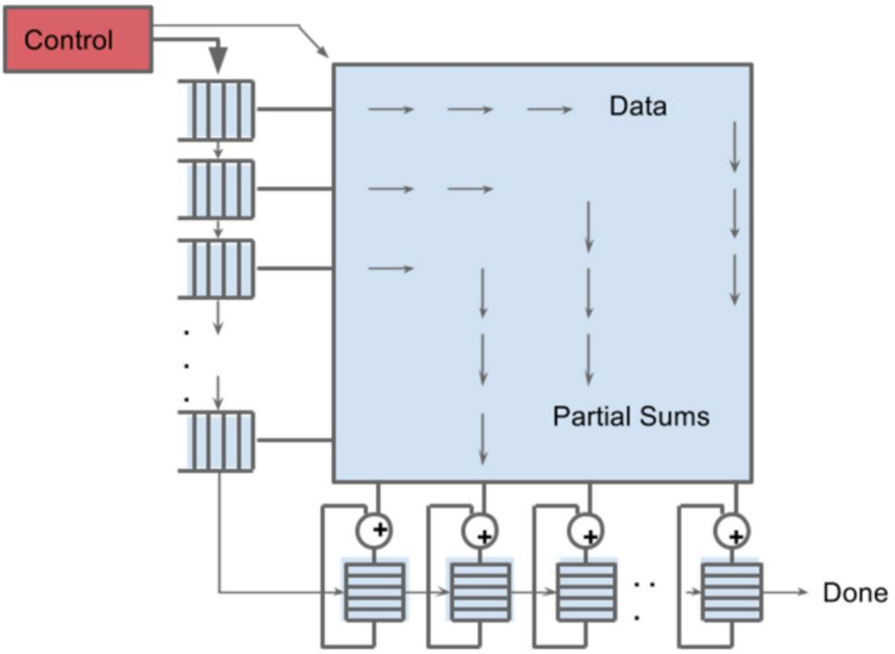
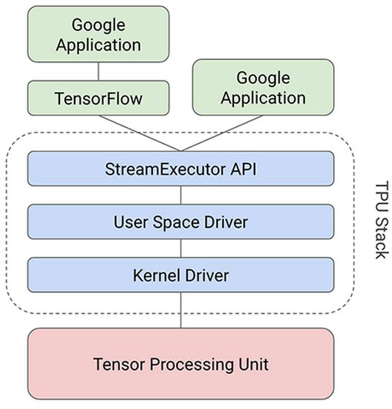
TPU
Tensor processing unit
An in-depth look at Google’s first Tensor Processing Unit (TPU)
Specifically designed
Structured ASIC
Systolic arrays for DNN
Matrix Multiplier Unit (MXU) of TPU
An in-depth look at Google’s first Tensor Processing Unit (TPU)

Slide 26
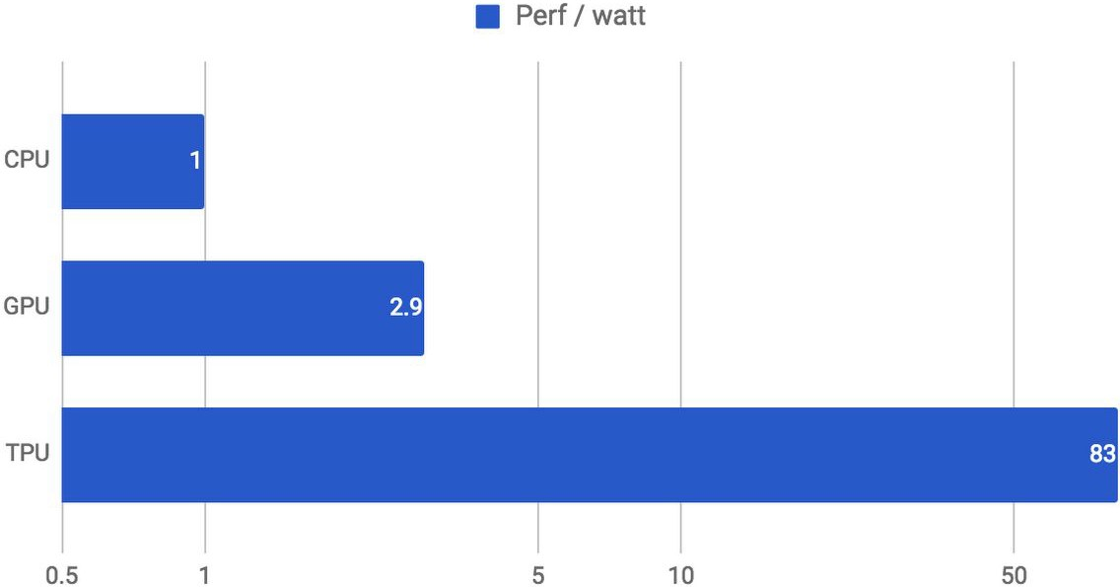
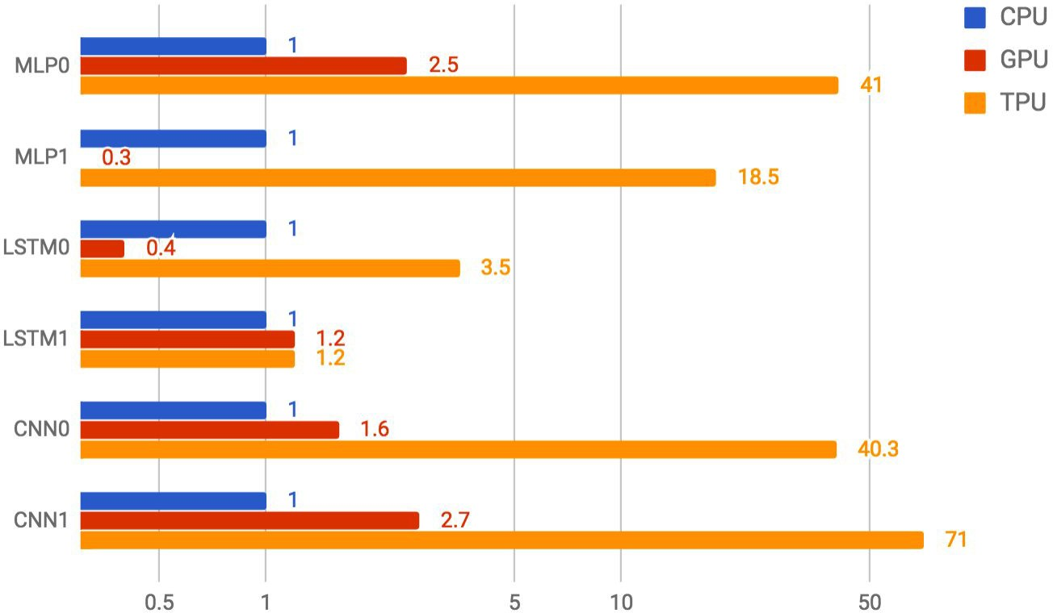
TPU Performance
An in-depth look at Google’s first Tensor Processing Unit (TPU)

Slide 27
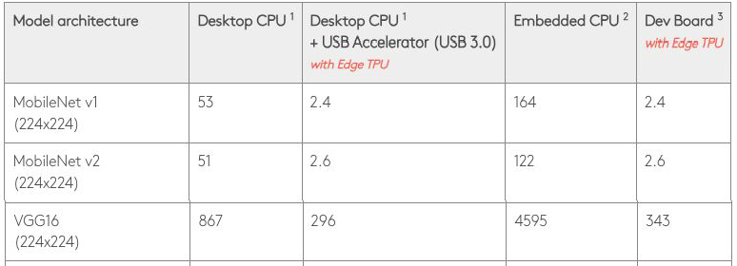
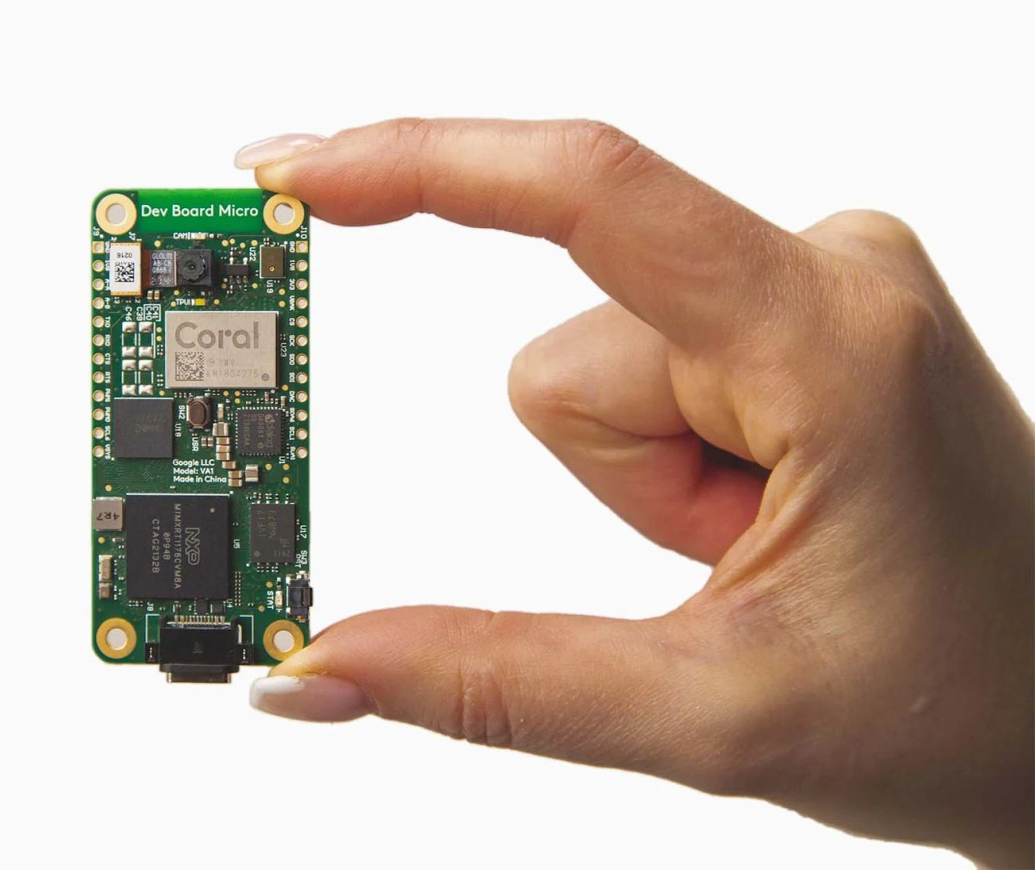
Coral Edge TPU
Products | Coral
Smaller Matrix Multiplier Unit (MXUs)
https://coral.ai/docs/edgetpu/benchmarks/

Slide 28
Edge Device Hardware Architecture

Slide 29
Sensors
Acoustic and vibration
Visual and scene
Motion and position
Force and tactile
Optical, electromagnetic, and radiation
Environmental, biological, and chemical

Slide 30
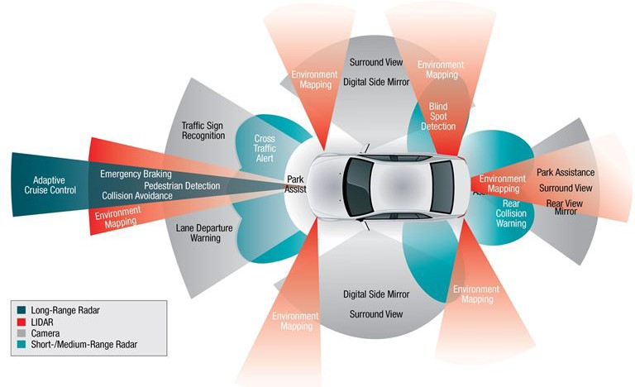
Sensors on Self-driving Cars

Slide 31
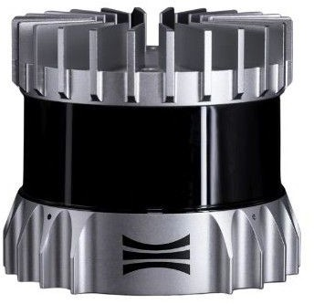
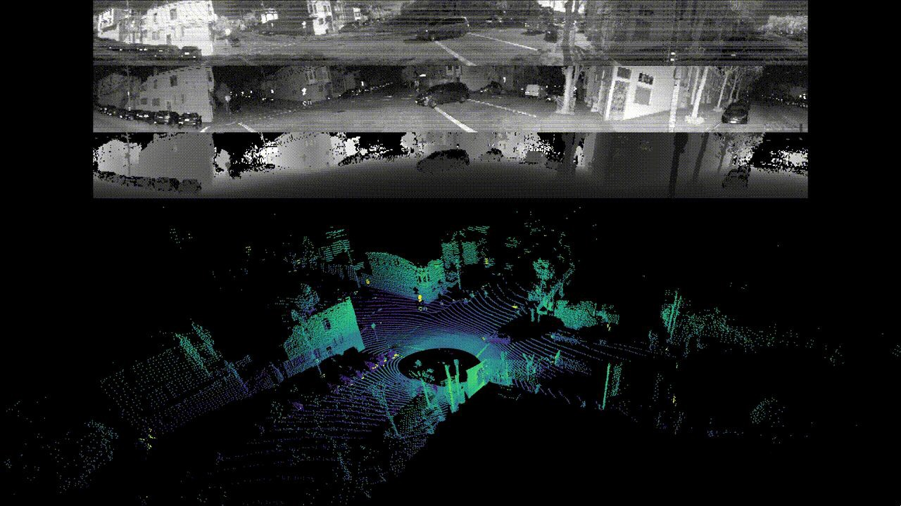
LiDAR
Vertical FOV
Light Detection and Ranging
Range
Vertical resolution (beams)
Horizontal resolution
Range resolution
Angular accuracy
FPS
Field of View (FOV)
Vertical
Horizontal
Example
Ouster OS1 Mid-Range Lidar
Ouster OS2 Long-Range Lidar
https://ouster.com/insights/blog/the-camera-is-in-the-lidar

Slide 32


Stereo Camera
Intrinsics
Aperture
Focal length
FOV
Sensor size
Shutter (rolling, global)
FPS
Resolution
Baseline (Stereo)
Example
ZED 2 - AI Stereo Camera
Intel® RealSense™ Depth and Tracking Cameras

Slide 33
Summary
CPU
Clock speed, memory speed, cores, threads, cache size
Memory
Cache
L1, L2, L3, cache hit & miss
RISC vs CISC
Special accelerators
GPU, TPU, systolic array, FPGA, ASIC
Sensors
LiDAR, Stereo Camera

Slide 34
Next Lecture
Middleware
Lab 4: Networking with Cloud

